Slide 1

ClimateLaunchpad 2017

Slide 2



Our Deal
Central budget +
10 k€/Competition

Slide 3

Who is the end user for our product?
Cleantech start ups with great potential

Slide 4
What is our user’s pain?
Not enough money and resources
Not the right network
Do not have the right tools for a business plan
Need coaching
Need time in spotlight

Slide 5
ClimateLaunchpad solves your pain
- How does it work?
1. Registration: Start ups <3 Competitions!
2. Boot camp: Here you’ll learn all you need to know to create your own high-level pitch deck + develop your business plan
3. Coaching: 6 sessions time to digest & perfect
4. Don’ t forget to Connect! Access to European new network

Slide 6
ClimateLaunchpad solves your pain
- How does it work?
5. National Final Sweden: = Pitch time!
Top 3 off to EU Final
6. EU Final Limassol: Pitch your idea in front of the EU’s leading investors and entrepreneurs.
7. Prizes: 10, 5 or 2,5 k€ + Access to
Climate-KIC Accelerator ´
-> Ready to rocket off the ClimateLaunchpad.
Time for Acceleration!

Slide 7
What do we need from you?
We need YOU to: Work hard, Dream BIG, Dazzle the Judges and Show the world what an awesome Start up you have (TGDIYCMN)
Judging criterias:
Business and market potential
Job potential or social impact
Innovation or technology potential
Climate impact
Strength management team
Quality of pitch

Slide 8
Founder’s dream
Create Europe’s largest business idea competition and Unlock Europe’s clean tech potential Year 1: 10 countries Year 2: 20 countries
Year 5: Go global
Spread the word: “Climate-KIC is da shit!”
Build an EU wide Clean-tech business network- Don’t forget to Connect!
Have Fun and Be inspired

Slide 9

Join even if it’s on the back of a Napkin!

Slide 10
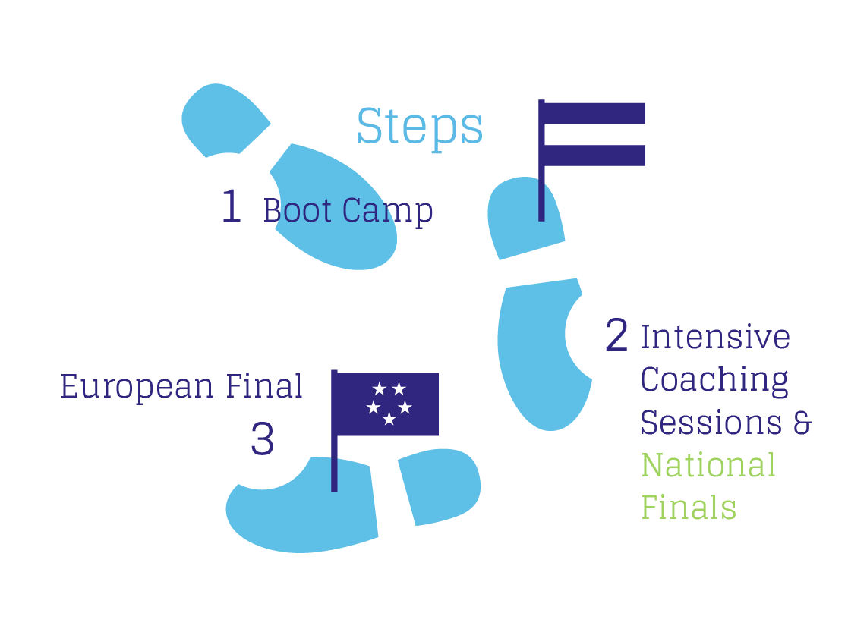
Schedule 2017
Applications Deadline:
11 June
Bootcamps:
29-30 June, Chalmers Venture
National Finals:
5 September, VentureLab
Grand Final:
17-18 October, Limassol, Cyprus

Slide 11
Qustions?
Sara Schützer
sara@climatelaunchpad.org
+46 (0) 722 282 645
Or say Hi to at the Venture café 16-18 today

Slide 12
35 participating countries in 2017
Armenia
Austria
Azerbaijan
Bangladesh
Belgium
Bulgaria
Cyprus
Denmark
England
Estonia
Finland
France
Germany
Greece
Hungary
Ireland
Israel
Italy
Kenya
Latvia
Lithuania
Moldova
Netherlands
Norway
Poland
Portugal
Romania
Scotland
Serbia
Slovenia
Spain
Sweden
Switzerland
Turkey
Ukraine

